Slide 1
第五章 线性方程组的迭代解法
李书杰
计算机与信息学院
合肥工业大学

Slide 2
提纲
基本迭代法
向量和矩阵的范数
收敛性分析

Slide 3
引言
求解大规模线性代数方程组
$$Ax=b$$
我们所要讨论的格式
$x^{(k+1)}=Bx^{（k）}+g$ , $k=0,1,2,⋯$
任意给定初始向量$x^{(0)}$，
利用上述迭代格式计算可得向量序列$\left\{x^{\left(k\right)}\}\right.$
如果$x^{\left(k\right)}→x^{∗}$，那么显然$x^{∗}$即为该方程组的解
取充分大的$k$，并以$x^{(k)}$作为该方程组的近似解

Slide 4

引言
线性代数方程组
$$\left\{\begin{aligned}a_{11}x_{1}+a_{12}x_{2}+…+a_{1n}x_{n}=b_{1} \\ a_{21}x_{1}+a_{22}x_{2}+…+a_{2n}x_{n}=b_{2} \\ ……. \\ a_{n1}x_{1}+a_{n2}x_{2}+…+a_{nn}x_{n}=b_{n}\end{aligned}\right.$$
本章将介绍三种基本迭代格式：
Jacobi迭代格式
Gauss-Seidel迭代格式
SOR迭代格式

Slide 5

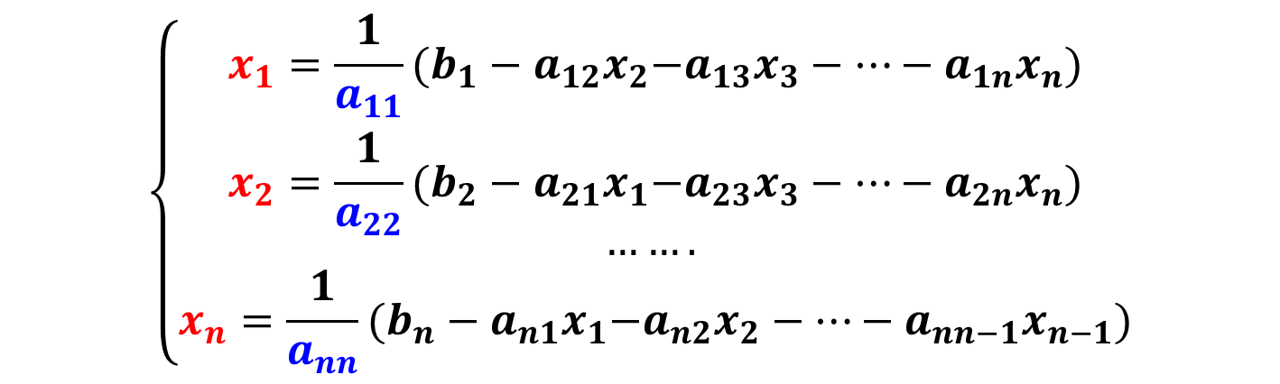
Jacobi迭代
线性代数方程组
$$\left\{\begin{aligned}a_{11}x_{1}+a_{12}x_{2}+…+a_{1n}x_{n}=b_{1} \\ a_{21}x_{1}+a_{22}x_{2}+…+a_{2n}x_{n}=b_{2} \\ ……. \\ a_{n1}x_{1}+a_{n2}x_{2}+…+a_{nn}x_{n}=b_{n}\end{aligned}\right.$$
从第$i$个方程解出第$i$个未知量：
$$\left\{\begin{aligned}x_{1}=\frac{1}{a_{11}}{(b_{1}−a_{12}x}_{2}−a_{13}x_{3}−…−a_{1n}x_{n}) \\ x_{2}=\frac{1}{a_{22}}{(b_{2}−a_{21}x}_{1}−a_{23}x_{3}−…−a_{2n}x_{n}) \\ ……. \\ x_{n}=\frac{1}{a_{nn}}{(b_{n}−a_{n1}x}_{1}−a_{n2}x_{2}−…−a_{nn−1}x_{n−1})\end{aligned}\right.$$

Slide 6
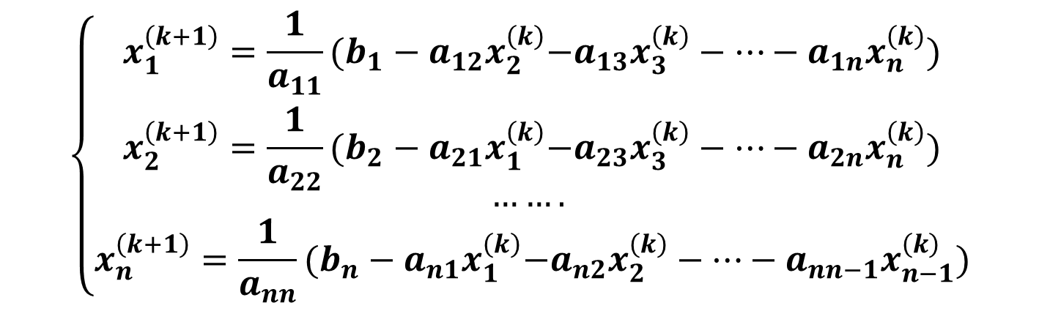
Jacobi迭代
等号左边加上标$(k+1)$，等号右边加上标$\left(k\right)$：
$$\left\{\begin{aligned}x_{1}^{\left(k+1\right)}=\frac{1}{a_{11}}{(b_{1}−a_{12}x}_{2}^{\left(k\right)}−a_{13}x_{3}^{\left(k\right)}−…−a_{1n}x_{n}^{\left(k\right)}) \\ x_{2}^{\left(k+1\right)}=\frac{1}{a_{22}}{(b_{2}−a_{21}x}_{1}^{\left(k\right)}−a_{23}x_{3}^{\left(k\right)}−…−a_{2n}x_{n}^{\left(k\right)}) \\ ……. \\ x_{n}^{\left(k+1\right)}=\frac{1}{a_{nn}}{(b_{n}−a_{n1}x}_{1}^{\left(k\right)}−a_{n2}x_{2}^{\left(k\right)}−…−a_{nn−1}x_{n−1}^{\left(k\right)})\end{aligned}\right.$$
这就是Jacobi迭代格式。

Slide 7
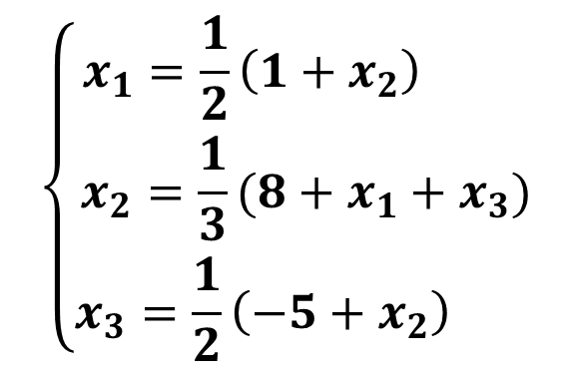
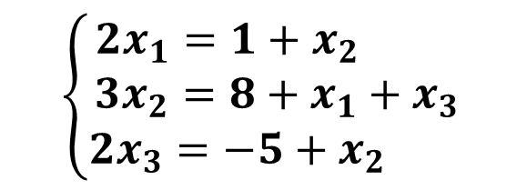

Jacobi迭代
例. 用Jacobi迭代求解线性方程组：
$$\left[\begin{matrix}2 & −1 & 0 \\ −1 & 3 & −1 \\ 0 & −1 & 2\end{matrix}\right]\left[\begin{matrix}x_{1} \\ x_{2} \\ x_{3}\end{matrix}\right]=\left[\begin{matrix}1 \\ 8 \\ −5\end{matrix}\right]$$
解：首先，写出Jacobi迭代格式
$$\left\{\begin{aligned}x_{1}=\frac{1}{2}\left(1+x_{2}\right) \\ {x_{2}=\frac{1}{3}(8+x}_{1}+x_{3}) \\ x_{3}=\frac{1}{2}\left(−5+x_{2}\right) \end{aligned}\right.$$
$$\left\{\begin{aligned}2x_{1}=1+x_{2} \\ {3x_{2}=8+x}_{1}+x_{3} \\ 2x_{3}=−5+x_{2} \end{aligned}\right.$$

Slide 8
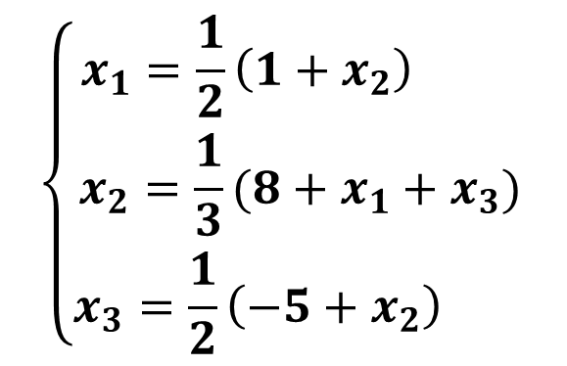
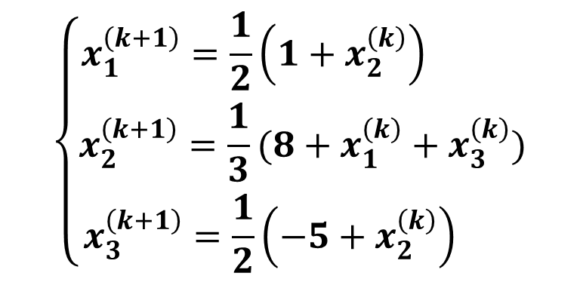
Jacobi迭代
例. 用Jacobi迭代求解线性方程组：
$$\left[\begin{matrix}2 & −1 & 0 \\ −1 & 3 & −1 \\ 0 & −1 & 2\end{matrix}\right]\left[\begin{matrix}x_{1} \\ x_{2} \\ x_{3}\end{matrix}\right]=\left[\begin{matrix}1 \\ 8 \\ −5\end{matrix}\right]$$
解：首先，写出Jacobi迭代格式
$$\left\{\begin{aligned}x_{1}=\frac{1}{2}\left(1+x_{2}\right) \\ {x_{2}=\frac{1}{3}(8+x}_{1}+x_{3}) \\ x_{3}=\frac{1}{2}\left(−5+x_{2}\right) \end{aligned}\right.$$
$$\left\{\begin{aligned}x_{1}^{\left(k+1\right)}=\frac{1}{2}\left(1+x_{2}^{\left(k\right)}\right) \\ x_{2}^{\left(k+1\right)}=\frac{1}{3}(8+x_{1}^{\left(k\right)}+x_{3}^{\left(k\right)}) \\ x_{3}^{\left(k+1\right)}=\frac{1}{2}\left(−5+x_{2}^{\left(k\right)}\right) \end{aligned}\right.$$

Slide 9
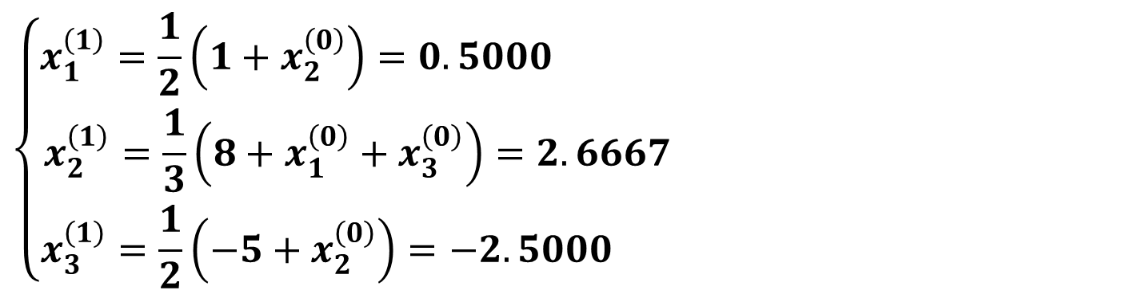
Jacobi迭代
例. 用Jacobi迭代求解线性方程组：
解：取初始值$x^{\left(0\right)}={\left[0,0,0\right]}^{T}$，令$k=0$，计算得
$$\left\{\begin{aligned}x_{1}^{\left(1\right)}=\frac{1}{2}\left(1+x_{2}^{\left(0\right)}\right)=0.5000 \\ x_{2}^{\left(1\right)}=\frac{1}{3}\left(8+x_{1}^{\left(0\right)}+x_{3}^{\left(0\right)}\right)=2.6667 \\ x_{3}^{\left(1\right)}=\frac{1}{2}\left(−5+x_{2}^{\left(0\right)}\right)=−2.5000 \end{aligned}\right.$$

Slide 10
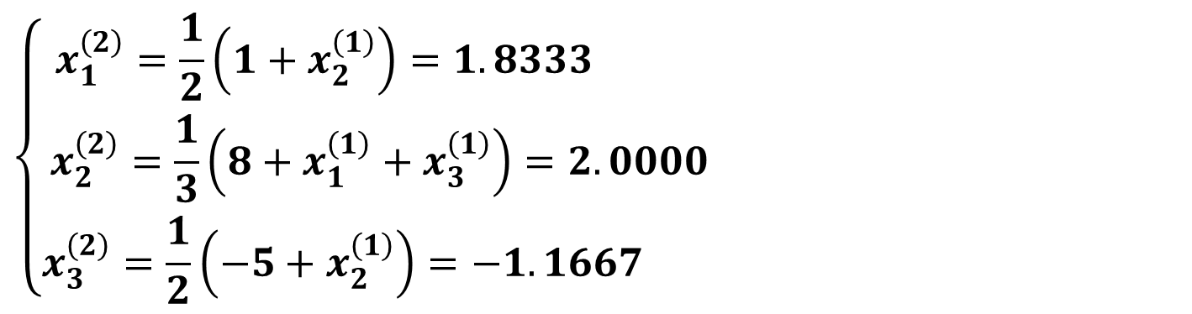
Jacobi迭代
例. 用Jacobi迭代求解线性方程组：
$$\left[\begin{matrix}2 & −1 & 0 \\ −1 & 3 & −1 \\ 0 & −1 & 2\end{matrix}\right]\left[\begin{matrix}x_{1} \\ x_{2} \\ x_{3}\end{matrix}\right]=\left[\begin{matrix}1 \\ 8 \\ −5\end{matrix}\right]$$
解：令$k=1$，计算得
$$\left\{\begin{aligned}x_{1}^{\left(2\right)}=\frac{1}{2}\left(1+x_{2}^{\left(1\right)}\right)=1.8333 \\ x_{2}^{\left(2\right)}=\frac{1}{3}\left(8+x_{1}^{\left(1\right)}+x_{3}^{\left(1\right)}\right)=2.0000 \\ x_{3}^{\left(2\right)}=\frac{1}{2}\left(−5+x_{2}^{\left(1\right)}\right)=−1.1667 \end{aligned}\right.$$

Slide 11
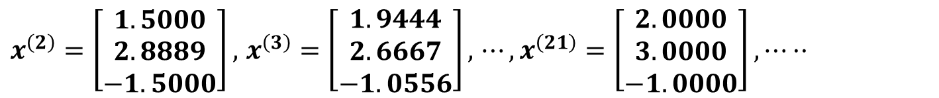
Jacobi迭代
例. 用Jacobi迭代求解线性方程组：
$$\left[\begin{matrix}2 & −1 & 0 \\ −1 & 3 & −1 \\ 0 & −1 & 2\end{matrix}\right]\left[\begin{matrix}x_{1} \\ x_{2} \\ x_{3}\end{matrix}\right]=\left[\begin{matrix}1 \\ 8 \\ −5\end{matrix}\right]$$
解：令$k=2,⋯$，计算得
$x^{\left(2\right)}=\left[\begin{matrix}1.5000 \\ 2.8889 \\ −1.5000\end{matrix}\right],$ $x^{\left(3\right)}=\left[\begin{matrix}1.9444 \\ 2.6667 \\ −1.0556\end{matrix}\right],$ $⋯,x^{\left(21\right)}=\left[\begin{matrix}2.0000 \\ 3.0000 \\ −1.0000\end{matrix}\right],⋯··$
显然，迭代21步后实际上就得到了保留5位有效数字的近似解。

Slide 12
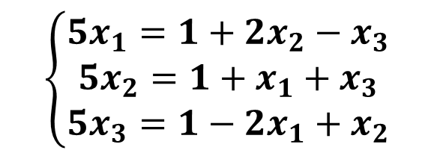

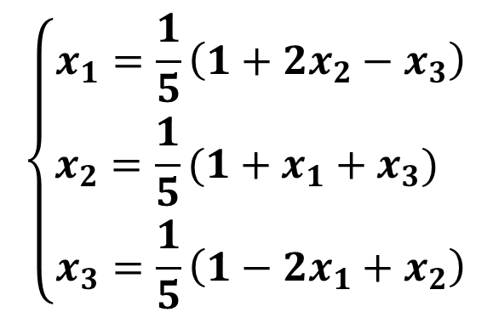
Jacobi迭代
练习. 用Jacobi迭代求解线性方程组：
$$\left\{\begin{aligned}5x_{1}−{2x}_{2}+x_{3}=1 \\ {−x}_{1}+5x_{2}−x_{3}=1 \\ 2x_{1}−x_{2}+5x_{3}=1\end{aligned}\right.$$
解：首先，写出Jacobi迭代格式
$$\left\{\begin{aligned}x_{1}=\frac{1}{5}\left(1+{2x}_{2}−x_{3}\right) \\ {x_{2}=\frac{1}{5}(1+x}_{1}+x_{3}) \\ x_{3}=\frac{1}{5}\left(1−2x_{1}+x_{2}\right)\end{aligned}\right.$$
$$\left\{\begin{aligned}5x_{1}=1+{2x}_{2}−x_{3} \\ {5x_{2}=1+x}_{1}+x_{3} \\ 5x_{3}=1−2x_{1}+x_{2}\end{aligned}\right.$$

Slide 13
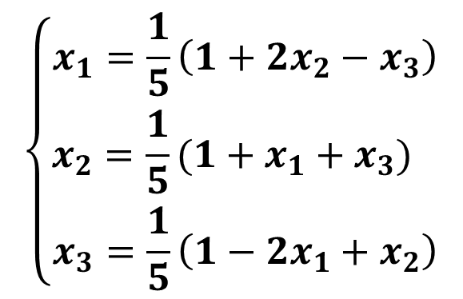
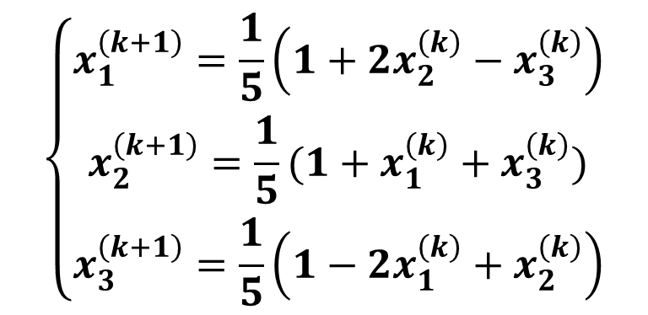
Jacobi迭代
练习. 用Jacobi迭代求解线性方程组：
$$\left\{\begin{aligned}5x_{1}−{2x}_{2}+x_{3}=1 \\ {−x}_{1}+5x_{2}−x_{3}=1 \\ 2x_{1}−x_{2}+5x_{3}=1\end{aligned}\right.$$
解：首先，写出Jacobi迭代格式
$$\left\{\begin{aligned}x_{1}=\frac{1}{5}\left(1+{2x}_{2}−x_{3}\right) \\ {x_{2}=\frac{1}{5}(1+x}_{1}+x_{3}) \\ x_{3}=\frac{1}{5}\left(1−2x_{1}+x_{2}\right)\end{aligned}\right.$$
$$\left\{\begin{aligned}x_{1}^{\left(k+1\right)}=\frac{1}{5}\left(1+2x_{2}^{\left(k\right)}−x_{3}^{\left(k\right)}\right) \\ x_{2}^{\left(k+1\right)}=\frac{1}{5}(1+x_{1}^{\left(k\right)}+x_{3}^{\left(k\right)}) \\ x_{3}^{\left(k+1\right)}=\frac{1}{5}\left(1−2x_{1}^{\left(k\right)}+x_{2}^{\left(k\right)}\right)\end{aligned}\right.$$

Slide 14
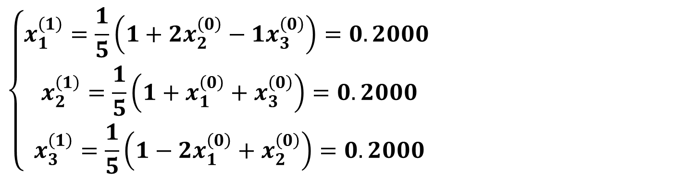
Jacobi迭代
练习. 用Jacobi迭代求解线性方程组：
$$\left\{\begin{aligned}5x_{1}−{2x}_{2}+x_{3}=1 \\ {−x}_{1}+5x_{2}−x_{3}=1 \\ 2x_{1}−x_{2}+5x_{3}=1\end{aligned}\right.$$
解：取初始值$x^{\left(0\right)}={\left[0,0,0\right]}^{T}$，令$k=0$，计算得
$$\left\{\begin{aligned}x_{1}^{\left(1\right)}=\frac{1}{5}\left(1+2x_{2}^{\left(0\right)}−1x_{3}^{\left(0\right)}\right)=0.2000 \\ x_{2}^{\left(1\right)}=\frac{1}{5}\left(1+x_{1}^{\left(0\right)}+x_{3}^{\left(0\right)}\right)=0.2000 \\ x_{3}^{\left(1\right)}=\frac{1}{5}\left(1−2x_{1}^{\left(0\right)}+x_{2}^{\left(0\right)}\right)=0.2000\end{aligned}\right.$$

Slide 15
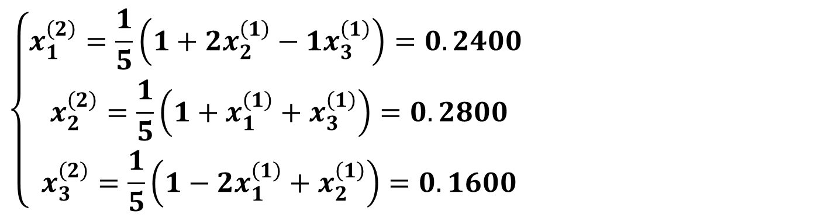
Jacobi迭代
练习. 用Jacobi迭代求解线性方程组：
$$\left\{\begin{aligned}5x_{1}−{2x}_{2}+x_{3}=1 \\ {−x}_{1}+5x_{2}−x_{3}=1 \\ 2x_{1}−x_{2}+5x_{3}=1\end{aligned}\right.$$
解：令$k=1$，计算得
$$\left\{\begin{aligned}x_{1}^{\left(2\right)}=\frac{1}{5}\left(1+2x_{2}^{\left(1\right)}−1x_{3}^{\left(1\right)}\right)=0.2400 \\ x_{2}^{\left(2\right)}=\frac{1}{5}\left(1+x_{1}^{\left(1\right)}+x_{3}^{\left(1\right)}\right)=0.2800 \\ x_{3}^{\left(2\right)}=\frac{1}{5}\left(1−2x_{1}^{\left(1\right)}+x_{2}^{\left(1\right)}\right)=0.1600\end{aligned}\right.$$

Slide 16
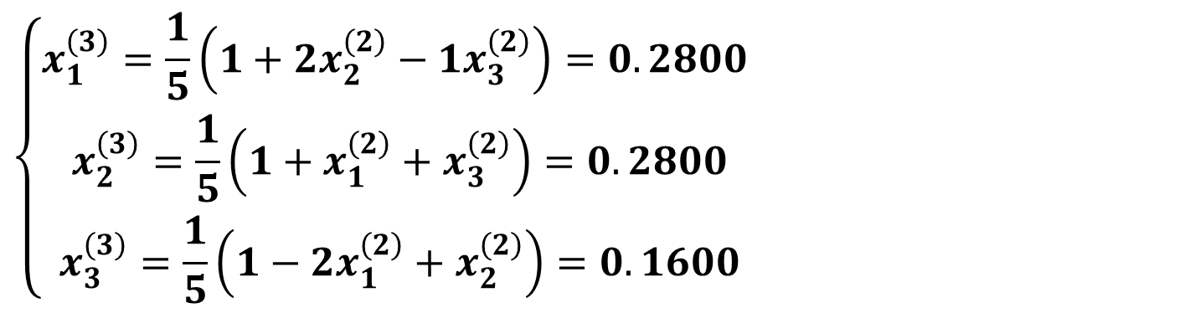
Jacobi迭代
练习. 用Jacobi迭代求解线性方程组：
$$\left\{\begin{aligned}5x_{1}−{2x}_{2}+x_{3}=1 \\ {−x}_{1}+5x_{2}−x_{3}=1 \\ 2x_{1}−x_{2}+5x_{3}=1\end{aligned}\right.$$
解：令$k=2$，计算得
$$\left\{\begin{aligned}x_{1}^{\left(3\right)}=\frac{1}{5}\left(1+2x_{2}^{\left(2\right)}−1x_{3}^{\left(2\right)}\right)=0.2800 \\ x_{2}^{\left(3\right)}=\frac{1}{5}\left(1+x_{1}^{\left(2\right)}+x_{3}^{\left(2\right)}\right)=0.2800 \\ x_{3}^{\left(3\right)}=\frac{1}{5}\left(1−2x_{1}^{\left(2\right)}+x_{2}^{\left(2\right)}\right)=0.1600\end{aligned}\right.$$

Slide 17
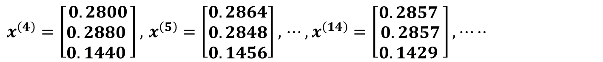
Jacobi迭代
练习. 用Jacobi迭代求解线性方程组：
解：令$k=3,⋯$，计算得
$x^{\left(4\right)}=\left[\begin{matrix}0.2800 \\ 0.2880 \\ 0.1440 \end{matrix}\right],$ $x^{\left(5\right)}=\left[\begin{matrix}0.2864 \\ 0.2848 \\ 0.1456\end{matrix}\right],$ $⋯,x^{\left(14\right)}=\left[\begin{matrix}0.2857 \\ 0.2857 \\ 0.1429 \end{matrix}\right],⋯··$

Slide 18
Jacobi迭代的矩阵形式
，其中，

Slide 19
Jacobi迭代的矩阵形式
，即
雅可比迭代公式的矩阵形式
其中，
称为雅可比迭代矩阵，

Slide 20
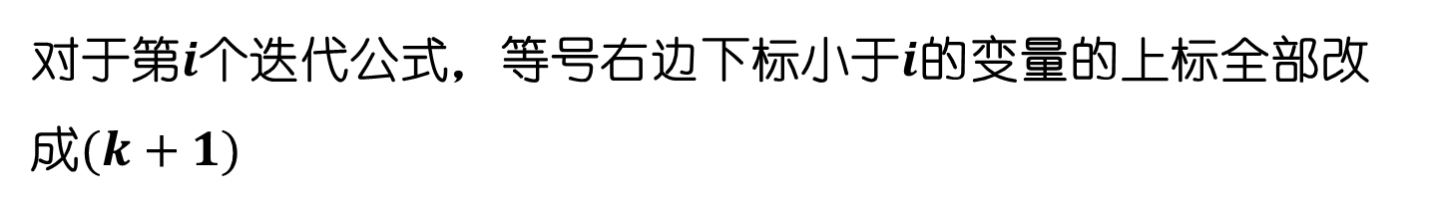
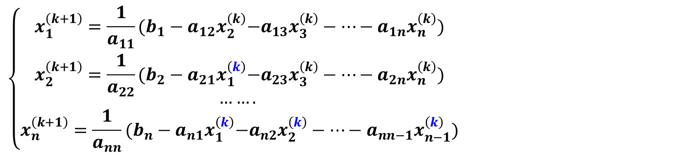
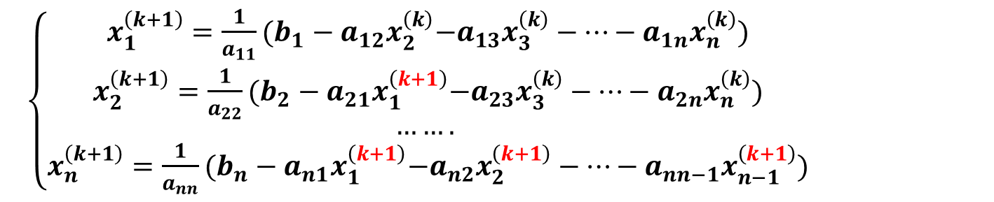
Gauss-Seidel迭代
由Jacobi迭代格式出发：
Jacobi迭代
$$\left\{\begin{aligned}x_{1}^{\left(k+1\right)}=\frac{1}{a_{11}}{(b_{1}−a_{12}x}_{2}^{\left(k\right)}−a_{13}x_{3}^{\left(k\right)}−…−a_{1n}x_{n}^{\left(k\right)}) \\ x_{2}^{\left(k+1\right)}=\frac{1}{a_{22}}{(b_{2}−a_{21}x}_{1}^{\left(k\right)}−a_{23}x_{3}^{\left(k\right)}−…−a_{2n}x_{n}^{\left(k\right)}) \\ ……. \\ x_{n}^{\left(k+1\right)}=\frac{1}{a_{nn}}{(b_{n}−a_{n1}x}_{1}^{\left(k\right)}−a_{n2}x_{2}^{\left(k\right)}−…−a_{nn−1}x_{n−1}^{\left(k\right)})\end{aligned}\right.$$
对于第$i$个迭代公式，等号右边下标小于$i$的变量的上标全部改成$(k+1)$
GS
迭代
$\left\{\begin{aligned}x_{1}^{\left(k+1\right)}=\frac{1}{a_{11}}{(b_{1}−a_{12}x}_{2}^{\left(k\right)}−a_{13}x_{3}^{\left(k\right)}−…−a_{1n}x_{n}^{\left(k\right)}) \\ x_{2}^{\left(k+1\right)}=\frac{1}{a_{22}}{(b_{2}−a_{21}x}_{1}^{\left(k+1\right)}−a_{23}x_{3}^{\left(k\right)}−…−a_{2n}x_{n}^{\left(k\right)}) \\ ……. \\ x_{n}^{\left(k+1\right)}=\frac{1}{a_{nn}}{(b_{n}−a_{n1}x}_{1}^{\left(k+1\right)}−a_{n2}x_{2}^{\left(k+1\right)}−…−a_{nn−1}x_{n−1}^{\left(k+1\right)})\end{aligned}\right.$

Slide 21
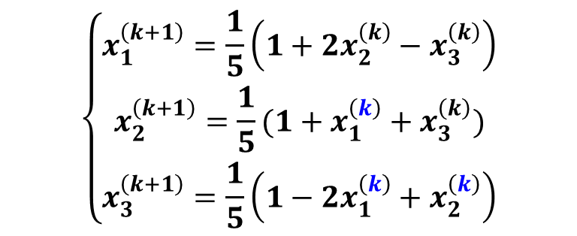
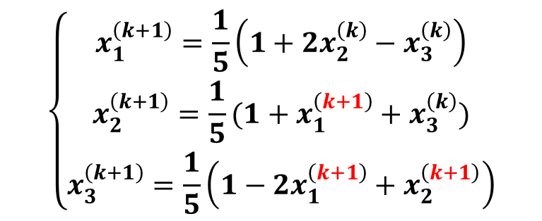
Gauss-Seidel迭代
练习. 用Gauss-Seidel迭代求解线性方程组：
$$\left\{\begin{aligned}5x_{1}−{2x}_{2}+x_{3}=1 \\ {−x}_{1}+5x_{2}−x_{3}=1 \\ 2x_{1}−x_{2}+5x_{3}=1\end{aligned}\right.$$
解：首先，写出Gauss-Seidel迭代格式
$$\left\{\begin{aligned}x_{1}^{\left(k+1\right)}=\frac{1}{5}\left(1+2x_{2}^{\left(k\right)}−x_{3}^{\left(k\right)}\right) \\ x_{2}^{\left(k+1\right)}=\frac{1}{5}(1+x_{1}^{\left(k\right)}+x_{3}^{\left(k\right)}) \\ x_{3}^{\left(k+1\right)}=\frac{1}{5}\left(1−2x_{1}^{\left(k\right)}+x_{2}^{\left(k\right)}\right)\end{aligned}\right.$$
$$\left\{\begin{aligned}x_{1}^{\left(k+1\right)}=\frac{1}{5}\left(1+2x_{2}^{\left(k\right)}−x_{3}^{\left(k\right)}\right) \\ x_{2}^{\left(k+1\right)}=\frac{1}{5}(1+x_{1}^{\left(k+1\right)}+x_{3}^{\left(k\right)}) \\ x_{3}^{\left(k+1\right)}=\frac{1}{5}\left(1−2x_{1}^{\left(k+1\right)}+x_{2}^{\left(k+1\right)}\right)\end{aligned}\right.$$
Jacobi迭代
Gauss-Seidel迭代

Slide 22

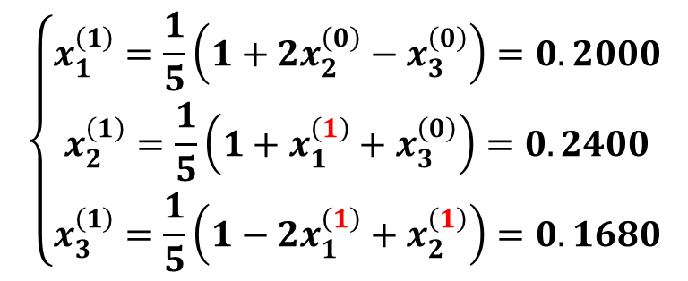
Gauss-Seidel迭代
练习. 用Gauss-Seidel迭代求解线性方程组：
$$\left\{\begin{aligned}3x_{1}−x_{2}−x_{3}=1 \\ {−x}_{1}+3x_{2}−x_{3}=1 \\ −x_{1}−x_{2}+3x_{3}=1\end{aligned}\right.$$
解：取初始值$x^{\left(0\right)}={\left[0,0,0\right]}^{T}$，令$k=0$，计算得
$$\left\{\begin{aligned}x_{1}^{\left(1\right)}=\frac{1}{5}\left(1+2x_{2}^{\left(0\right)}−x_{3}^{\left(0\right)}\right)=0.2000 \\ x_{2}^{\left(1\right)}=\frac{1}{5}\left(1+x_{1}^{\left(1\right)}+x_{3}^{\left(0\right)}\right)=0.2400 \\ x_{3}^{\left(1\right)}=\frac{1}{5}\left(1−2x_{1}^{\left(1\right)}+x_{2}^{\left(1\right)}\right)=0.1680\end{aligned}\right.$$

Slide 23
Gauss-Seidel迭代的矩阵形式
矩阵表示
G-S迭代公式的矩阵形式

Slide 24
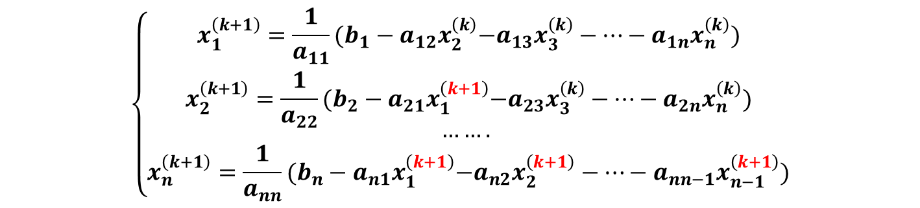
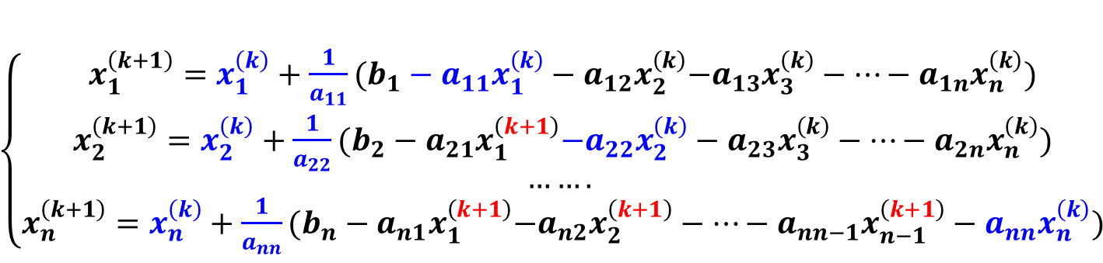
SOR迭代
由GS迭代格式出发：
$$\left\{\begin{aligned}x_{1}^{\left(k+1\right)}=\frac{1}{a_{11}}{(b_{1}−a_{12}x}_{2}^{\left(k\right)}−a_{13}x_{3}^{\left(k\right)}−…−a_{1n}x_{n}^{\left(k\right)}) \\ x_{2}^{\left(k+1\right)}=\frac{1}{a_{22}}{(b_{2}−a_{21}x}_{1}^{\left(k+1\right)}−a_{23}x_{3}^{\left(k\right)}−…−a_{2n}x_{n}^{\left(k\right)}) \\ ……. \\ x_{n}^{\left(k+1\right)}=\frac{1}{a_{nn}}{(b_{n}−a_{n1}x}_{1}^{\left(k+1\right)}−a_{n2}x_{2}^{\left(k+1\right)}−…−a_{nn−1}x_{n−1}^{\left(k+1\right)})\end{aligned}\right.$$
对于第$i$个迭代公式，等号右边改写成
$\left\{\begin{aligned}x_{1}^{\left(k+1\right)}=x_{1}^{\left(k\right)}+\frac{1}{a_{11}}{(b_{1}−a_{11}x_{1}^{\left(k\right)}−a_{12}x}_{2}^{\left(k\right)}−a_{13}x_{3}^{\left(k\right)}−…−a_{1n}x_{n}^{\left(k\right)}) \\ x_{2}^{\left(k+1\right)}=x_{2}^{\left(k\right)}+\frac{1}{a_{22}}{(b_{2}−a_{21}x}_{1}^{\left(k+1\right)}−a_{22}x_{2}^{\left(k\right)}−a_{23}x_{3}^{\left(k\right)}−…−a_{2n}x_{n}^{\left(k\right)}) \\ ……. \\ x_{n}^{\left(k+1\right)}=x_{n}^{\left(k\right)}+\frac{1}{a_{nn}}{(b_{n}−a_{n1}x}_{1}^{\left(k+1\right)}−a_{n2}x_{2}^{\left(k+1\right)}−…−a_{nn−1}x_{n−1}^{\left(k+1\right)}−a_{nn}x_{n}^{\left(k\right)})\end{aligned}\right.$

Slide 25

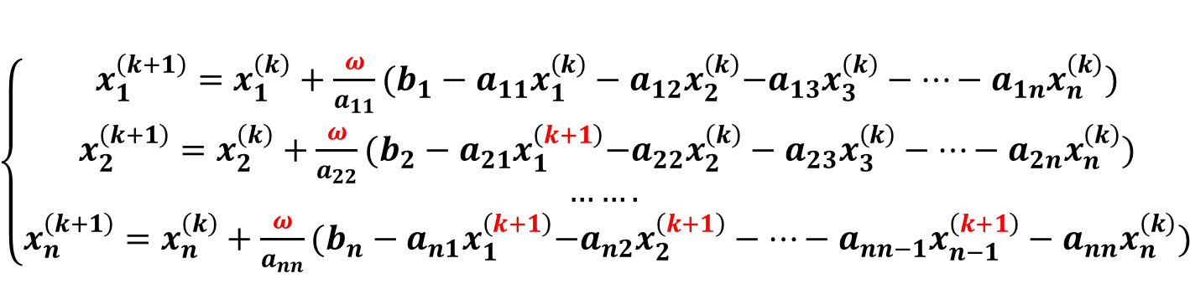
SOR迭代
由GS迭代格式出发：
GS迭代就是$ω=1$时的SOR迭代！
$$\left\{\begin{aligned}x_{1}^{\left(k+1\right)}=\frac{1}{a_{11}}{(b_{1}−a_{12}x}_{2}^{\left(k\right)}−a_{13}x_{3}^{\left(k\right)}−…−a_{1n}x_{n}^{\left(k\right)}) \\ x_{2}^{\left(k+1\right)}=\frac{1}{a_{22}}{(b_{2}−a_{21}x}_{1}^{\left(k+1\right)}−a_{23}x_{3}^{\left(k\right)}−…−a_{2n}x_{n}^{\left(k\right)}) \\ ……. \\ x_{n}^{\left(k+1\right)}=\frac{1}{a_{nn}}{(b_{n}−a_{n1}x}_{1}^{\left(k+1\right)}−a_{n2}x_{2}^{\left(k+1\right)}−…−a_{nn−1}x_{n−1}^{\left(k+1\right)})\end{aligned}\right.$$
对于第i个迭代公式，等号右边加上松弛因子
SOR迭代
$\left\{\begin{aligned}x_{1}^{\left(k+1\right)}=x_{1}^{\left(k\right)}+\frac{ω}{a_{11}}{(b_{1}−a_{11}x_{1}^{\left(k\right)}−a_{12}x}_{2}^{\left(k\right)}−a_{13}x_{3}^{\left(k\right)}−…−a_{1n}x_{n}^{\left(k\right)}) \\ x_{2}^{\left(k+1\right)}=x_{2}^{\left(k\right)}+\frac{ω}{a_{22}}{(b_{2}−a_{21}x}_{1}^{\left(k+1\right)}−a_{22}x_{2}^{\left(k\right)}−a_{23}x_{3}^{\left(k\right)}−…−a_{2n}x_{n}^{\left(k\right)}) \\ ……. \\ x_{n}^{\left(k+1\right)}=x_{n}^{\left(k\right)}+\frac{ω}{a_{nn}}{(b_{n}−a_{n1}x}_{1}^{\left(k+1\right)}−a_{n2}x_{2}^{\left(k+1\right)}−…−a_{nn−1}x_{n−1}^{\left(k+1\right)}−a_{nn}x_{n}^{\left(k\right)})\end{aligned}\right.$

Slide 26
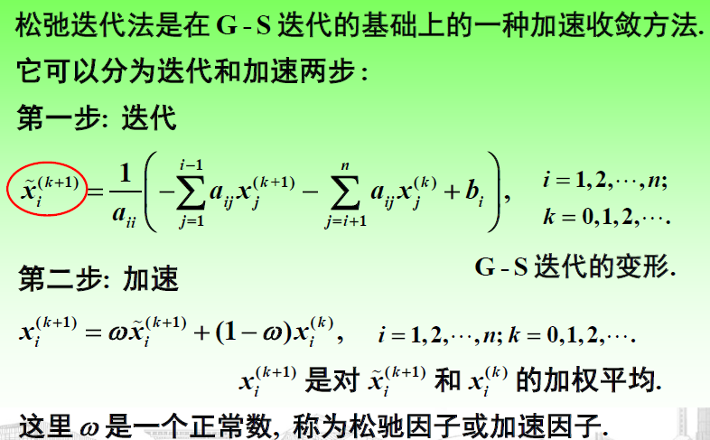
SOR迭代法

Slide 27
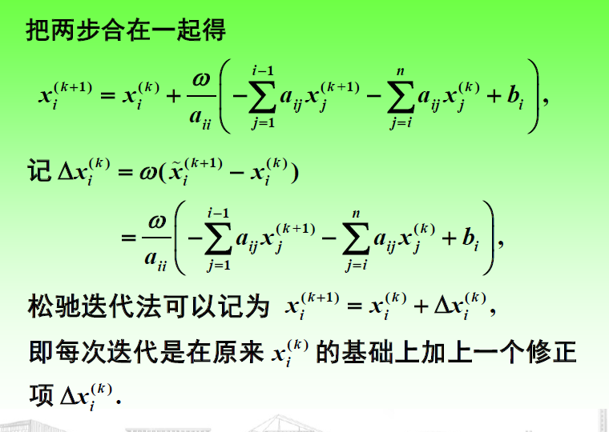

Slide 28
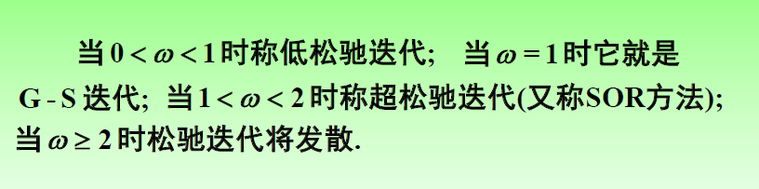
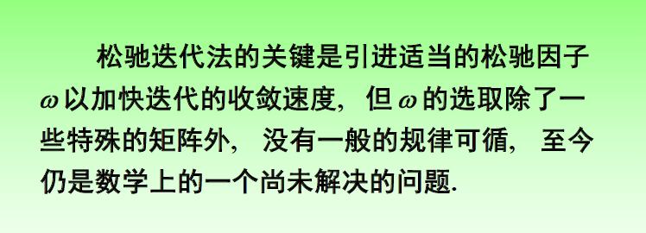

Slide 29
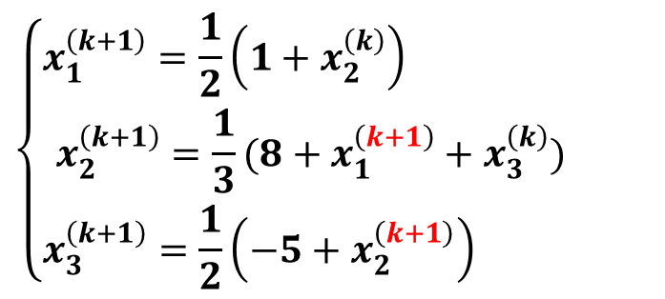

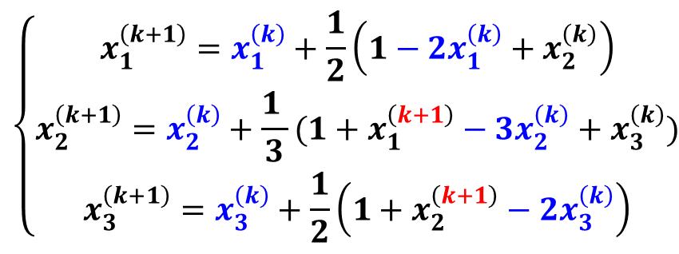
SOR迭代
例. 用SOR迭代(松弛因子$ω=1.1$)求解线性方程组：
$$\left[\begin{matrix}2 & −1 & 0 \\ −1 & 3 & −1 \\ 0 & −1 & 2\end{matrix}\right]\left[\begin{matrix}x_{1} \\ x_{2} \\ x_{3}\end{matrix}\right]=\left[\begin{matrix}1 \\ 8 \\ −5\end{matrix}\right]$$
解：首先，写出SOR迭代格式
$$\left\{\begin{aligned}x_{1}^{\left(k+1\right)}=\frac{1}{2}\left(1+x_{2}^{\left(k\right)}\right) \\ x_{2}^{\left(k+1\right)}=\frac{1}{3}(8+x_{1}^{\left(k+1\right)}+x_{3}^{\left(k\right)}) \\ x_{3}^{\left(k+1\right)}=\frac{1}{2}\left(−5+x_{2}^{\left(k+1\right)}\right) \end{aligned}\right.$$
$$\left\{\begin{aligned}x_{1}^{\left(k+1\right)}=x_{1}^{\left(k\right)}+\frac{1}{2}\left(1−{2x}_{1}^{\left(k\right)}+x_{2}^{\left(k\right)}\right) \\ x_{2}^{\left(k+1\right)}=x_{2}^{\left(k\right)}+\frac{1 }{3}(1+x_{1}^{\left(k+1\right)}−3x_{2}^{\left(k\right)}+x_{3}^{\left(k\right)}) \\ x_{3}^{\left(k+1\right)}=x_{3}^{\left(k\right)}+\frac{1}{2}\left(1+x_{2}^{\left(k+1\right)}−2x_{3}^{\left(k\right)}\right)\end{aligned}\right.$$
Gauss-Seidel迭代
Gauss-Seidel迭代

Slide 30

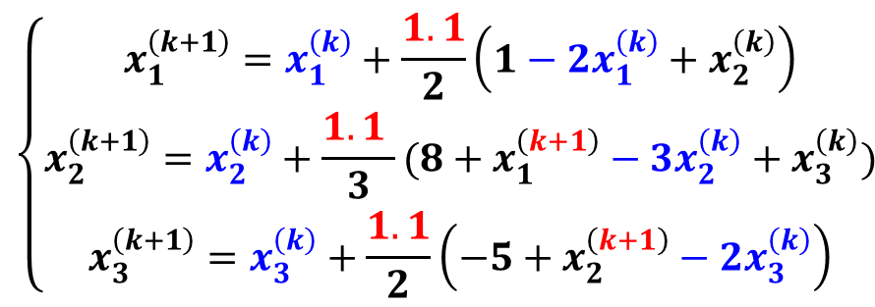
SOR迭代
例. 用SOR迭代(松弛因子$ω=1.1$)求解线性方程组：
$$\left[\begin{matrix}2 & −1 & 0 \\ −1 & 3 & −1 \\ 0 & −1 & 2\end{matrix}\right]\left[\begin{matrix}x_{1} \\ x_{2} \\ x_{3}\end{matrix}\right]=\left[\begin{matrix}1 \\ 8 \\ −5\end{matrix}\right]$$
解：首先，写出SOR迭代格式
$$\left\{\begin{aligned}x_{1}^{\left(k+1\right)}=\frac{1}{2}\left(1+x_{2}^{\left(k\right)}\right) \\ x_{2}^{\left(k+1\right)}=\frac{1}{3}(8+x_{1}^{\left(k+1\right)}+x_{3}^{\left(k\right)}) \\ x_{3}^{\left(k+1\right)}=\frac{1}{2}\left(−5+x_{2}^{\left(k+1\right)}\right) \end{aligned}\right.$$
$$\left\{\begin{aligned}x_{1}^{\left(k+1\right)}=x_{1}^{\left(k\right)}+\frac{1.1}{2}\left(1−{2x}_{1}^{\left(k\right)}+x_{2}^{\left(k\right)}\right) \\ x_{2}^{\left(k+1\right)}=x_{2}^{\left(k\right)}+\frac{1.1 }{3}(8+x_{1}^{\left(k+1\right)}−3x_{2}^{\left(k\right)}+x_{3}^{\left(k\right)}) \\ x_{3}^{\left(k+1\right)}=x_{3}^{\left(k\right)}+\frac{1.1}{2}\left(−5+x_{2}^{\left(k+1\right)}−2x_{3}^{\left(k\right)}\right)\end{aligned}\right.$$
Gauss-Seidel迭代
SOR迭代

Slide 31
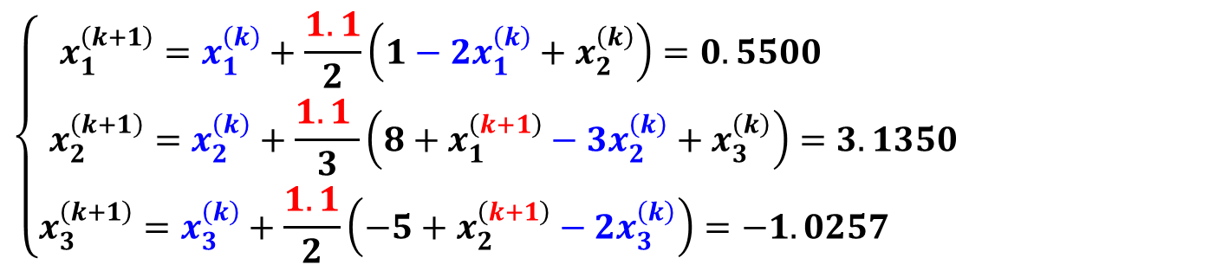
SOR迭代
例. 用SOR迭代(松弛因子$ω=1.1$)求解线性方程组：
$$\left[\begin{matrix}2 & −1 & 0 \\ −1 & 3 & −1 \\ 0 & −1 & 2\end{matrix}\right]\left[\begin{matrix}x_{1} \\ x_{2} \\ x_{3}\end{matrix}\right]=\left[\begin{matrix}1 \\ 8 \\ −5\end{matrix}\right]$$
解：取初始值$x^{\left(0\right)}={\left[0,0,0\right]}^{T}$，令$k=0$，计算得
$$\left\{\begin{aligned}x_{1}^{\left(k+1\right)}=x_{1}^{\left(k\right)}+\frac{1.1}{2}\left(1−{2x}_{1}^{\left(k\right)}+x_{2}^{\left(k\right)}\right)=0.5500 \\ x_{2}^{\left(k+1\right)}=x_{2}^{\left(k\right)}+\frac{1.1 }{3}\left(8+x_{1}^{\left(k+1\right)}−3x_{2}^{\left(k\right)}+x_{3}^{\left(k\right)}\right)=3.1350 \\ x_{3}^{\left(k+1\right)}=x_{3}^{\left(k\right)}+\frac{1.1}{2}\left(−5+x_{2}^{\left(k+1\right)}−2x_{3}^{\left(k\right)}\right)=−1.0257 \end{aligned}\right.$$

Slide 32
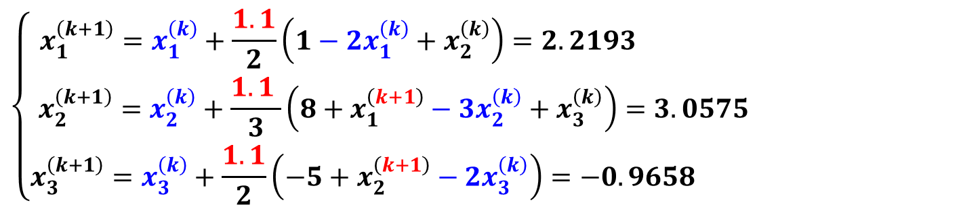
SOR迭代
例. 用SOR迭代(松弛因子$ω=1.1$)求解线性方程组：
$$\left[\begin{matrix}2 & −1 & 0 \\ −1 & 3 & −1 \\ 0 & −1 & 2\end{matrix}\right]\left[\begin{matrix}x_{1} \\ x_{2} \\ x_{3}\end{matrix}\right]=\left[\begin{matrix}1 \\ 8 \\ −5\end{matrix}\right]$$
解：令$k=1$，计算得
$$\left\{\begin{aligned}x_{1}^{\left(k+1\right)}=x_{1}^{\left(k\right)}+\frac{1.1}{2}\left(1−{2x}_{1}^{\left(k\right)}+x_{2}^{\left(k\right)}\right)=2.2193 \\ x_{2}^{\left(k+1\right)}=x_{2}^{\left(k\right)}+\frac{1.1 }{3}\left(8+x_{1}^{\left(k+1\right)}−3x_{2}^{\left(k\right)}+x_{3}^{\left(k\right)}\right)=3.0575 \\ x_{3}^{\left(k+1\right)}=x_{3}^{\left(k\right)}+\frac{1.1}{2}\left(−5+x_{2}^{\left(k+1\right)}−2x_{3}^{\left(k\right)}\right)=−0.9658 \end{aligned}\right.$$

Slide 33
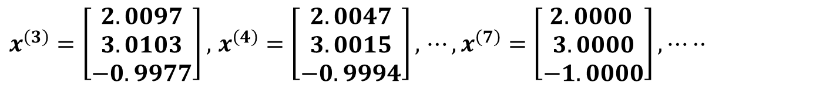
SOR迭代
例. 用SOR迭代(松弛因子$ω=1.1$)求解线性方程组：
$$\left[\begin{matrix}2 & −1 & 0 \\ −1 & 3 & −1 \\ 0 & −1 & 2\end{matrix}\right]\left[\begin{matrix}x_{1} \\ x_{2} \\ x_{3}\end{matrix}\right]=\left[\begin{matrix}1 \\ 8 \\ −5\end{matrix}\right]$$
解：令$k=$2$,⋯$，计算得
$x^{\left(3\right)}=\left[\begin{matrix}2.0097 \\ 3.0103 \\ −0.9977\end{matrix}\right],$ $x^{\left(4\right)}=\left[\begin{matrix}2.0047 \\ 3.0015 \\ −0.9994\end{matrix}\right],$ $⋯,x^{\left(7\right)}=\left[\begin{matrix}2.0000 \\ 3.0000 \\ −1.0000\end{matrix}\right],⋯··$

Slide 34
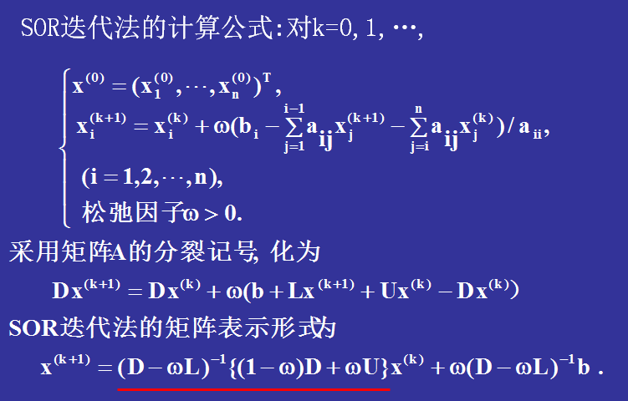
SOR迭代的矩阵形式

Slide 35
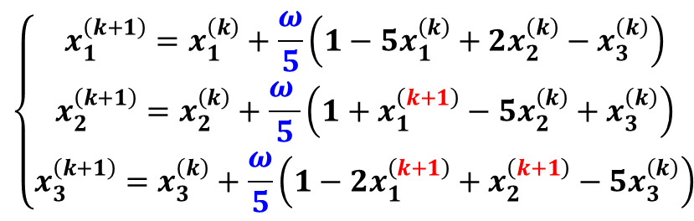
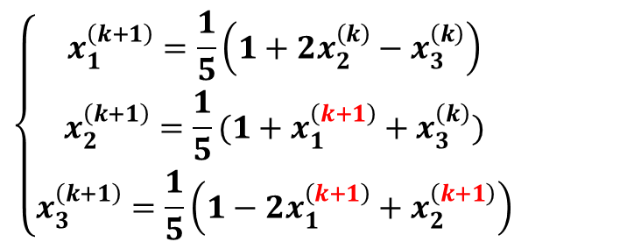
SOR迭代
练习. 用SOR迭代(松弛因子$ω=1.2$)求解线性方程组：
$$\left\{\begin{aligned}5x_{1}−{2x}_{2}+x_{3}=1 \\ {−x}_{1}+5x_{2}−x_{3}=1 \\ 2x_{1}−x_{2}+5x_{3}=1\end{aligned}\right.$$
解：首先，写出SOR迭代格式
$$\left\{\begin{aligned}x_{1}^{\left(k+1\right)}=\frac{1}{5}\left(1+2x_{2}^{\left(k\right)}−x_{3}^{\left(k\right)}\right) \\ x_{2}^{\left(k+1\right)}=\frac{1}{5}(1+x_{1}^{\left(k+1\right)}+x_{3}^{\left(k\right)}) \\ x_{3}^{\left(k+1\right)}=\frac{1}{5}\left(1−2x_{1}^{\left(k+1\right)}+x_{2}^{\left(k+1\right)}\right)\end{aligned}\right.$$
$$\left\{\begin{aligned}x_{1}^{\left(k+1\right)}=x_{1}^{\left(k\right)}+\frac{ω}{5}\left(1−5x_{1}^{\left(k\right)}+2x_{2}^{\left(k\right)}−x_{3}^{\left(k\right)}\right) \\ x_{2}^{\left(k+1\right)}=x_{2}^{\left(k\right)}+\frac{ω }{5}\left(1+x_{1}^{\left(k+1\right)}−5x_{2}^{\left(k\right)}+x_{3}^{\left(k\right)}\right) \\ x_{3}^{\left(k+1\right)}=x_{3}^{\left(k\right)}+\frac{ω}{5}\left(1−2x_{1}^{\left(k+1\right)}+x_{2}^{\left(k+1\right)}−5x_{3}^{\left(k\right)}\right)\end{aligned}\right.$$
Gauss-Seidel迭代
SOR迭代

Slide 36
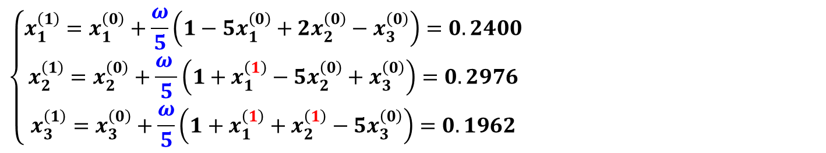
SOR迭代
练习. 用SOR迭代(松弛因子$ω=1.2$)求解线性方程组：
$$\left\{\begin{aligned}5x_{1}−{2x}_{2}+x_{3}=1 \\ {−x}_{1}+5x_{2}−x_{3}=1 \\ 2x_{1}−x_{2}+5x_{3}=1\end{aligned}\right.$$
解：取初始值$x^{\left(0\right)}={\left[0,0,0\right]}^{T}$，令$k=0$，计算得
$$\left\{\begin{aligned}x_{1}^{\left(1\right)}=x_{1}^{\left(0\right)}+\frac{ω}{5}\left(1−5x_{1}^{\left(0\right)}+2x_{2}^{\left(0\right)}−x_{3}^{\left(0\right)}\right)=0.2400 \\ x_{2}^{\left(1\right)}=x_{2}^{\left(0\right)}+\frac{ω }{5}\left(1+x_{1}^{\left(1\right)}−5x_{2}^{\left(0\right)}+x_{3}^{\left(0\right)}\right)=0.2976 \\ x_{3}^{\left(1\right)}=x_{3}^{\left(0\right)}+\frac{ω}{5}\left(1+x_{1}^{\left(1\right)}+x_{2}^{\left(1\right)}−5x_{3}^{\left(0\right)}\right)=0.1962\end{aligned}\right.$$

Slide 37
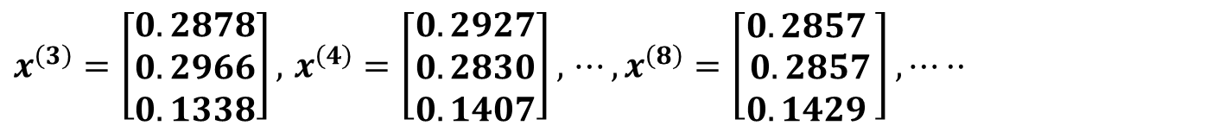
SOR迭代
练习. 用SOR迭代(松弛因子$ω=1.2$)求解线性方程组：
$$\left\{\begin{aligned}5x_{1}−{2x}_{2}+x_{3}=1 \\ {−x}_{1}+5x_{2}−x_{3}=1 \\ 2x_{1}−x_{2}+5x_{3}=1\end{aligned}\right.$$
解：令$k=2,⋯$，计算得
$x^{\left(3\right)}=\left[\begin{matrix}0.2878 \\ 0.2966 \\ 0.1338\end{matrix}\right],$ $x^{\left(4\right)}=\left[\begin{matrix}0.2927 \\ 0.2830 \\ 0.1407\end{matrix}\right],$ $⋯,x^{\left(8\right)}=\left[\begin{matrix}0.2857 \\ 0.2857 \\ 0.1429 \end{matrix}\right],⋯··$

Slide 38
提纲
基本迭代法
向量和矩阵的范数
收敛性分析

Slide 39
向量的范数

Slide 40
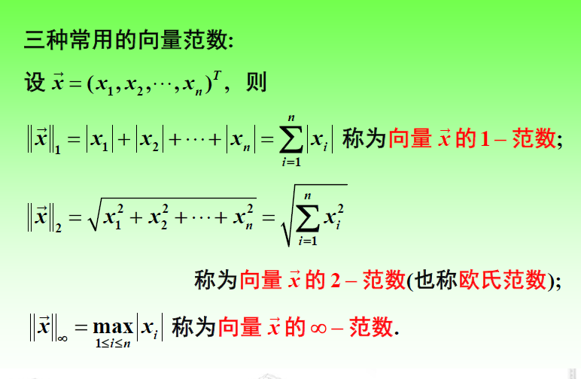

Slide 41
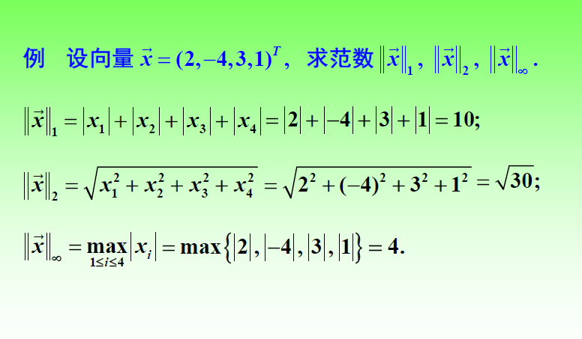
向量的范数

Slide 42
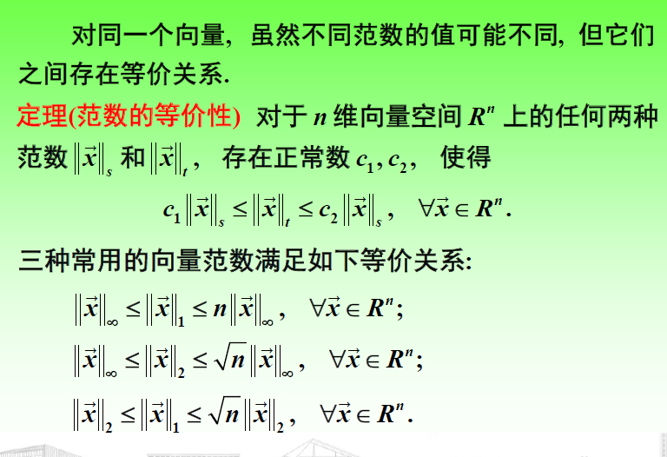

Slide 43
证明（1）:
所以
证明（2）:
所以

Slide 44
证明（3）:
所以

Slide 45
向量的收敛性
定义2 设 中一向量序列 ，其中
，如果存在
满足
则称向量序列 依坐标收敛到 ，记作
如果有
则称向量序列 依范数 收敛到 。

Slide 46
矩阵的范数

Slide 47
相容范数

Slide 48
算子范数

Slide 49
算子范数

Slide 51
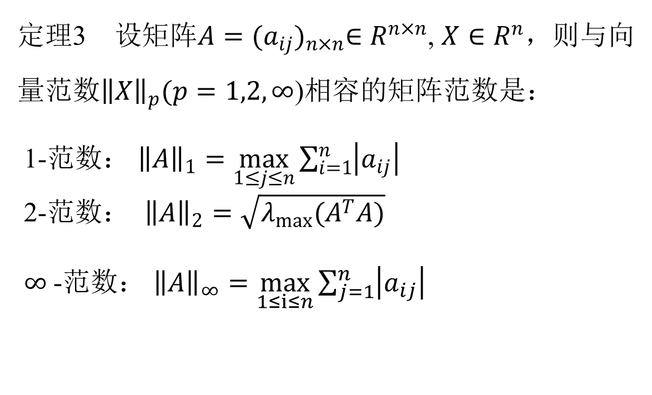
常见的矩阵范数
定理3 设矩阵$A={(a_{ij})}_{n×n}∈R^{n×n}$, $X∈R^{n}，$则与向量范数${\left\|X\right\|}_{p}(p=1,2,∞$)相容的矩阵范数是：
1-范数： ${\left\|A\right\|}_{1}=\max_{1≤j≤n}{\sum_{i=1}^{n}{\left|a_{ij}\right|}}$
2-范数： ${\left\|A\right\|}_{2}=\sqrt{λ_{max}(A^{T}A)}$
$∞$-范数： ${\left\|A\right\|}_{∞}=\max_{1≤i≤n}{\sum_{j=1}^{n}{\left|a_{ij}\right|}}$

Slide 52
常见的矩阵范数

Slide 53
常见的矩阵范数

Slide 54
例题

Slide 55
矩阵的谱半径和矩阵序列收敛性

Slide 56
例题

Slide 57
谱半径和范数的关系

Slide 58
提纲
基本迭代法
向量和矩阵的范数
收敛性分析

Slide 59
线性方程组迭代法收敛条件

Slide 60
迭代法的收敛条件

Slide 61
迭代法的收敛条件

Slide 62
迭代法的误差估计

Slide 63
迭代法的误差估计

Slide 64
迭代法的误差估计

Slide 65
收敛的判别条件

Slide 66
收敛的判别条件

Slide 67
例题

Slide 70
例题

